Slide 1
The Best Teacher Ever
By: Mr. Linweber

Slide 2
Once upon a very funny teacher lived in a small yellow and blue house by a river.

Slide 3
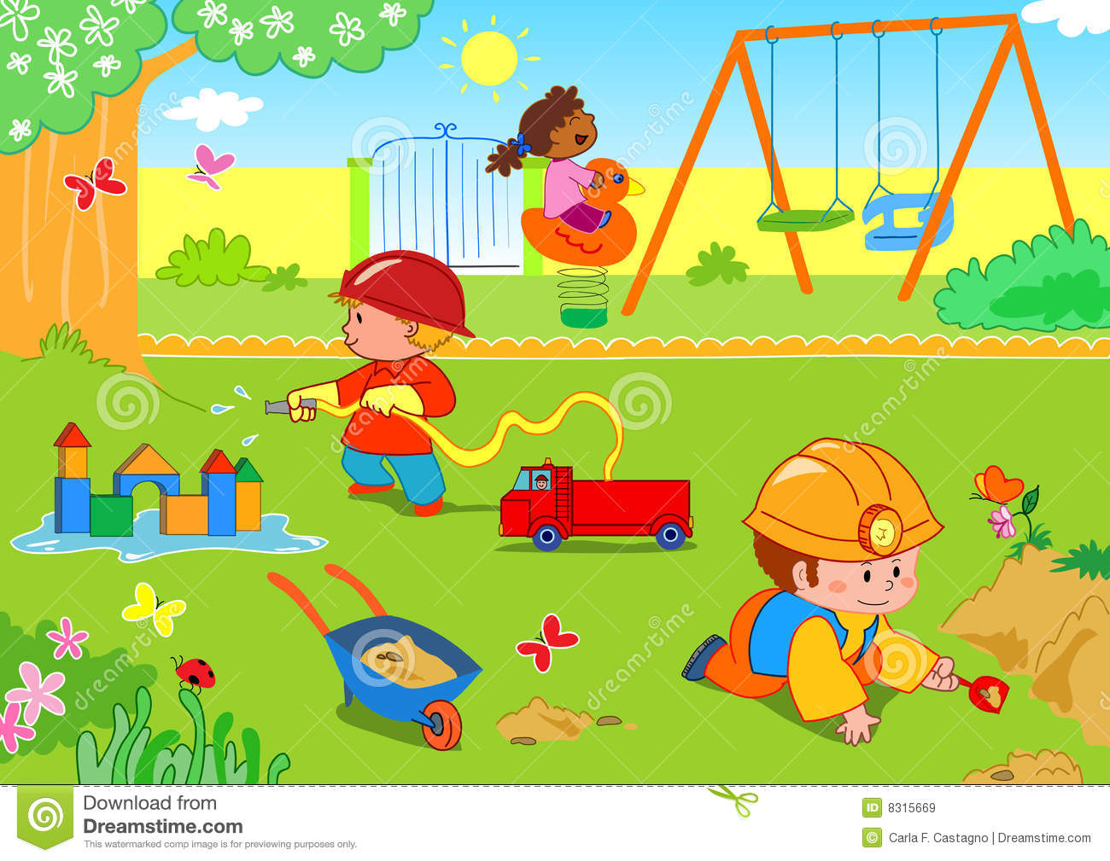
The teacher loved to take his class to this nice park in Brandon.

Slide 4
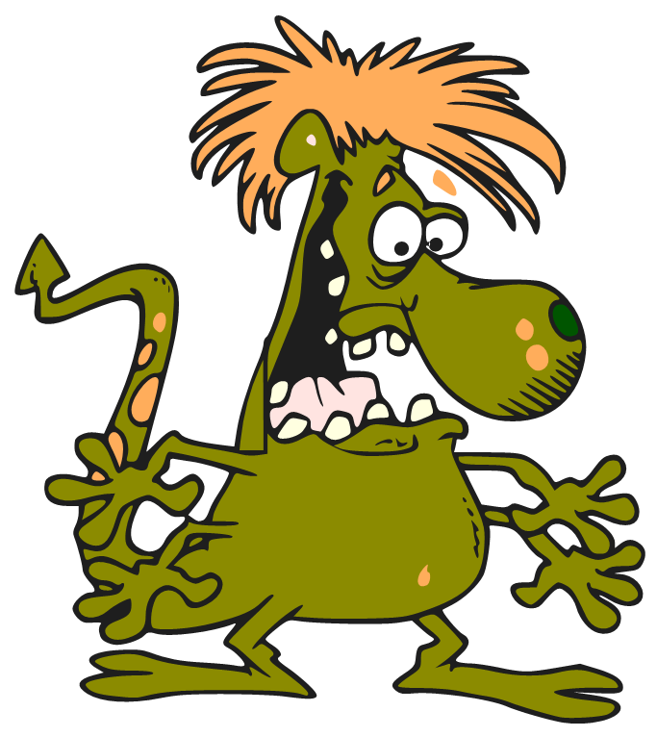
Then one hot summer day the teacher went to the park with his students. Then they were at the park they met this mean troll called Andrea.

Slide 5
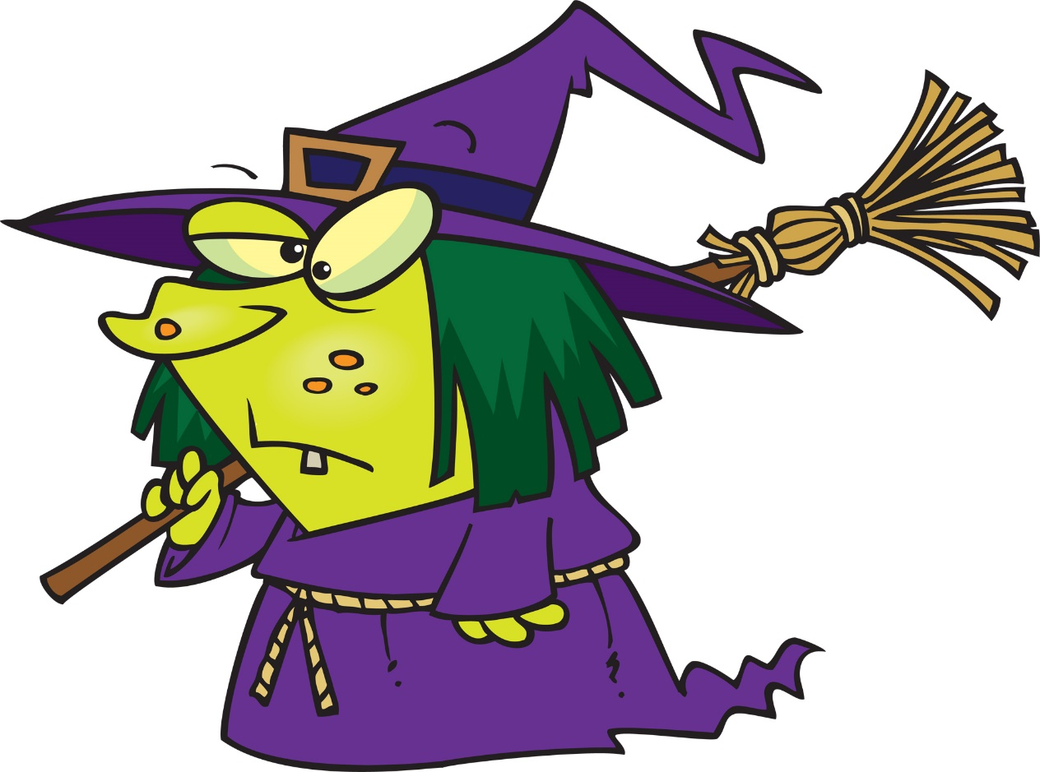
The nice teacher felt bad for the troll and went over to talk to it. He found out that the troll was under a spell from the evil witch Jill.

Slide 6
So the teacher called his uncle Kory and asked him what to do. Uncle Kory was a cook at RBE and knew everything about witches and their spells.

Slide 7
Uncle Kory made the potion in the lunch room for the teacher and his class. He told him to drink the potion and after she drinks it he has to kiss the troll.

Slide 8
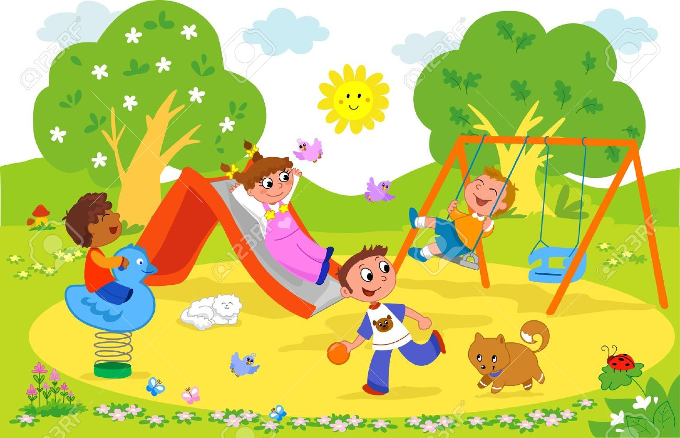
So the teacher and the students went back to the park to help and save the sad troll.

Slide 9
The teacher told the troll to drink the potion and then they would have to kiss. The troll was very nervous.

Slide 10
The troll took the potion and then gave the teacher a kiss. Then a big BOOM happened and smoke went every where.

Slide 11
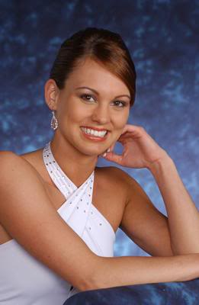
When the smoke cleared the troll had turned into this beautiful princess. The teacher fainted in shock.

Slide 12
The teacher and Andrea the old troll fell in love and got married the next day.
THE END

