Slide 1
The Night of the Missing Cat
By Mr. Linneweber

Slide 2
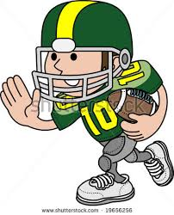
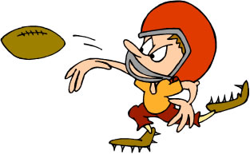
Three years later and the teacher’s family was happier than they had ever been. That is, as happy as you can be with two terrible behaving children like Scott and Aaron. It was a beautiful spring day with flowers in bloom, and the family was playing a friendly game of football.

Slide 3
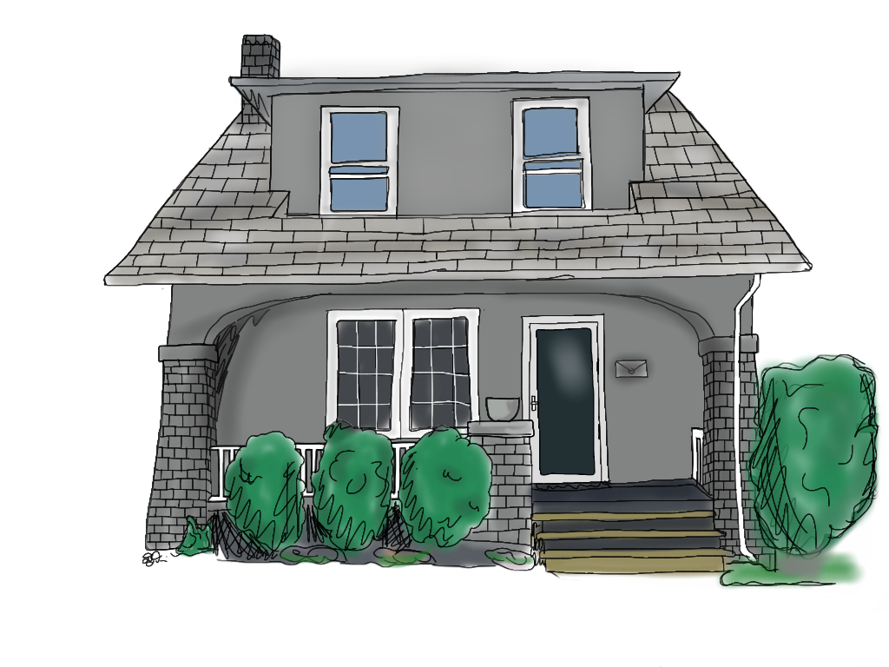
The sun started to set on the horizon, so the family thought it would be a good time to go home and eat. Turning the corner they noticed that the front door was wide open. They sprinted to the house like a pack of wolves. When they got to the house they noticed a couple things.

Slide 4
The teacher noticed a whistle laying on the floor by the kitchen table. Andrea saw a can of hair spray that her friend Mrs. Uithoven uses at school. The boys also saw a jump rope that they used all the time at recess dangling from the cookie jar. The family was really curious as to what was going on and started to look for their cat Anne. They looked all over and couldn’t find her. Someone must have stole her.

Slide 5
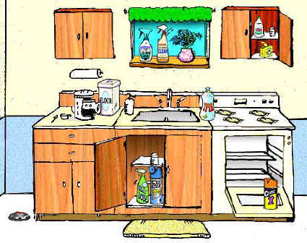
The teacher made supper and put the boys to bed. After putting them to bed the teacher asked Andrea to talk about the clues that they had found. Andrea new that Mrs. Uithoven must have been in the house. The teacher new that Mr. Plummer had a whistle just like that. They both new that the jump rope was Mrs. Tschetter’s favorite rope and used it all the time. What were they going to do. Why would they steal their cat Anne.

Slide 6
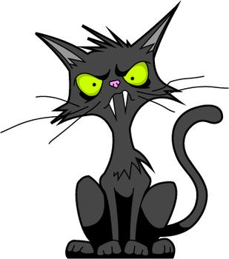
They kept talking that night and came up with a plan for the following day at school to find out which one had stolen their cat. They would need the help of the boys though.

Slide 7
The next day when Andrea went to her classroom she saw Mrs. Uithoven and her hair was all over the place. Andrea asked her what was wrong. Mrs. Uithoven said that she ran out of hair spray and didn’t have time to get any. She then asked her what she did this weekend. Mrs. Uithoven said she was in a MMA tournament this weekend in Corson and got 2nd place.

Slide 8
The teacher had PE right away that day and noticed that Mr. Plummer didn’t have his whistle around his neck. The teacher asked him where it was, and Mr. Plummer said he had no idea. He said he left it on his desk on Friday after school. The teacher then asked Mr. Plummer what he did this weekend. He said he had a model shoot in Rowena for an underwear company. Mr. Plummer does modeling on the side when not teaching.

Slide 9
At first recess that day, the boys ran to get Mrs. Tschetter’s favorite jump rope and it was not there. They went up and asked her and she said she had no idea. She was crying! She missed the jump rope so much. The mean boys said “suck it up” and laughed at her as they ran away to bully whoever they would find.

Slide 10
That day at lunch the teacher and Andrea talked about what to do next. They decided that Mrs. Tschetter was out because she missed her jump rope so much, so that left Mr. Plummer and Mrs. Uithoven.

Slide 11
They decided that they needed to split up at the end of the day and follow them home. It was going to be risky but that was the only way that they were going to find Anne.

Slide 12
So after school the teacher followed Mr. Plummer with little Scott and Andrea followed Mrs. Uithoven with little Arron to find precious Anne. Mr. Plummer lives in the basement of Gold’s Gym and Mrs. U lives upstairs of Pedro’s Pizza.

Slide 13
When the teacher arrived at Mr. Plummer’s place they went around back and looked in the basement window. To their surprise Mr. Plummer had changed into tights and a tank top. On the TV was a recording of dancing with the stars. He was actually really good the teacher and Scott thought. They didn’t see any signs of Anne anywhere in his apartment.

Slide 14
Andrea and Aaron followed Mrs. U to her apartment. The two needed a way to see inside her upstairs apartment. Aaron snuck around the corner and stole a ladder from Linneweber Plumbing to see inside the second floor window. When they ran the ladder up the side of the building they saw the most shocking thing ever.

Slide 15
As Andrea looked into the window the surprise almost knocked both Aaron and her off the ladder. Mrs. U was the craziest cat lady they have ever seen. She had a million cats running around her house. Four cats were actually riding on her shoulders when she walked into her kitchen. Andrea got on the phone and called the cops.

Slide 16
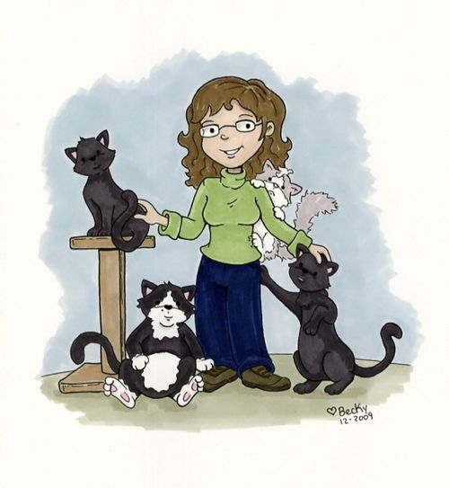
The cops arrived the same time that the teacher and Scott did. The cops broke down the door and the cats ran like a herd of buffalo on the prairie. They called for Anne and she scampered right over to the boys for a hug. Mrs. U eventually came out of her apartment and the cops took her to jail. The family returned home and hoped to see themselves on the 6 o’clock news.
The End

